Slide 1
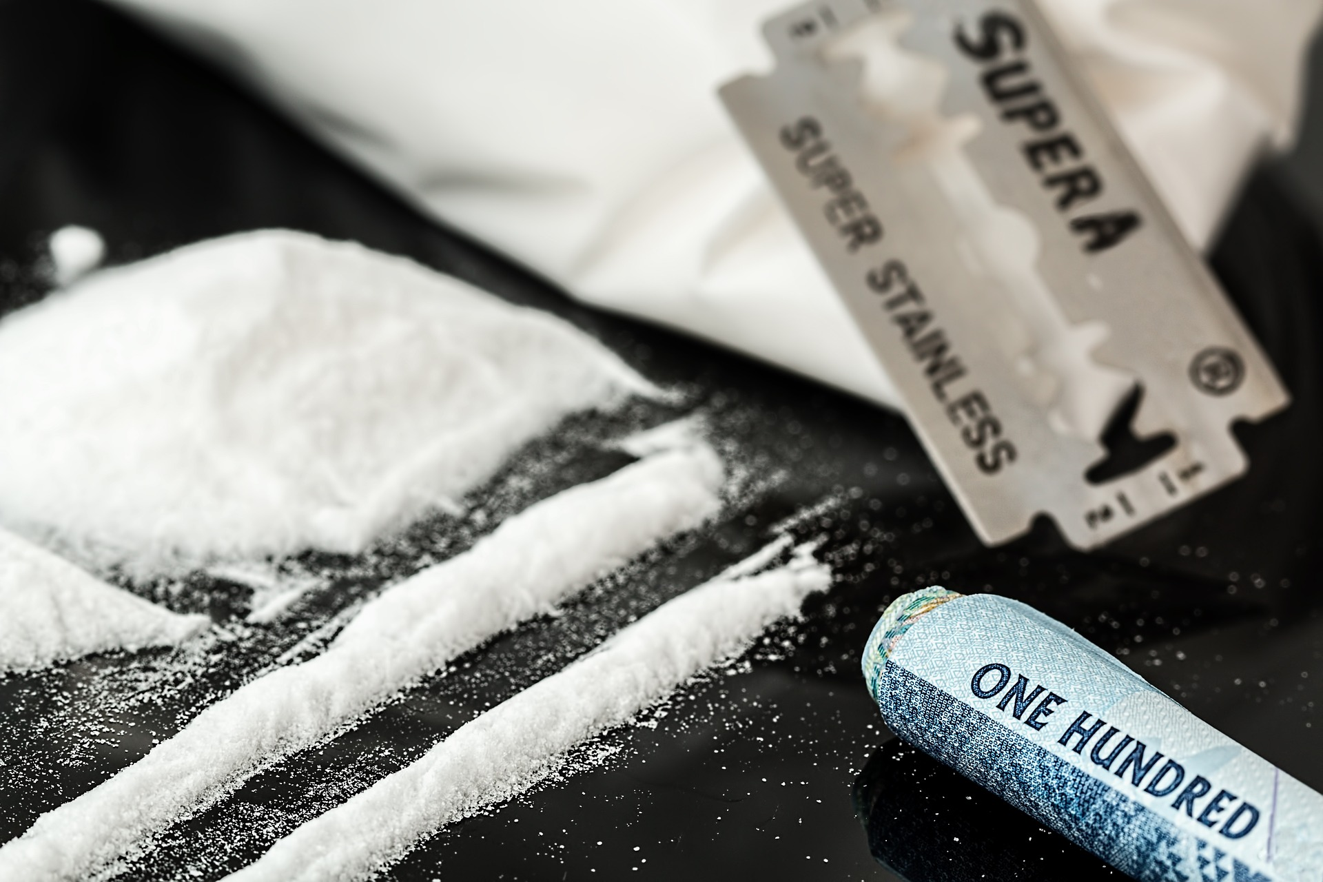
Predicting Illegal
Drugs Consumption
Elaborated by Elvis Davalillo
August 2019
Notes:
Due to all the buzz on drugs due to the Marihuana legalization in the state I decided to work on a project related to drugs

Slide 2
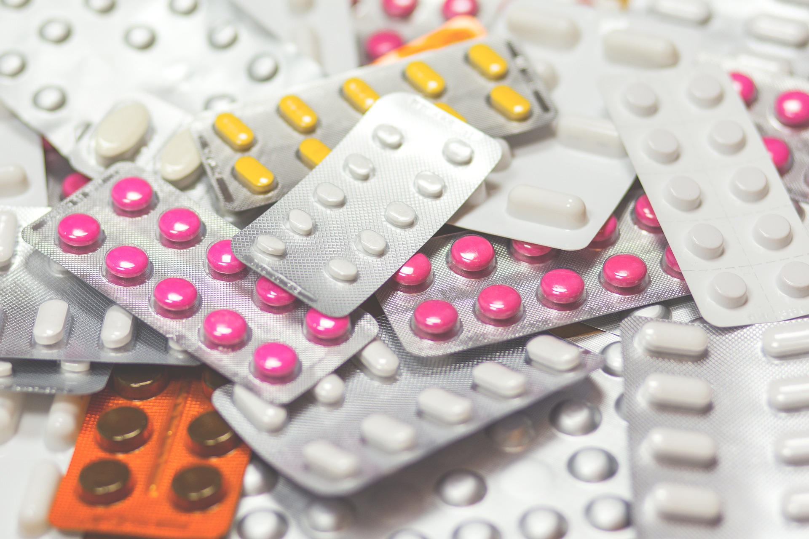
Summary
Predict if a person does illegal drugs depending on demographics, health, and general lifestyle habits
This model could reduce companies drug screening costs for new hires, among other applications
Notes:
At the beginning I was a bit skeptical, can we really predict if somebody does drugs depending on demographics, health, and general lifestyle habits? The answer is yes
Create a model that could be use in a real life situation

Slide 3
Can we predict if somebody does illegal drugs? How? *cocaine, heroine, hallucinogens... (marijuana is not considered illegal)
Notes:
- Define illegal drugs, that are also call illicit drugs includes cocaine, heroine, hallucinogens, among others

Slide 4
Data Gathering and EDA
2017 National Survey on Drug Use and Health results (56,000 observations/people)
Model features were selected survey responses such as age, educational level, alcohol consumption… (+25)
Target Variable is illegal drugs consumption
~11% of survey respondents
Modeling
Selected survey answers were cleaned, scaled, and transform for modeling
Multiple models were ran using techniques such as cross validation, oversampling, and grid search
Most predictive model was a logistic regression with and AUC ROC of 0.88
The model was uploaded to a flask app after minor modifications
Notes:
Data Gathering and EDA
Data comes from the 2017 National Survey on Drug Use and Health results that surveys 56,000 across the US about Drug Use and Health topics.
Our target variable (what we are trying to predict is illegal drugs consumption), which is a binomial feature.
Or classes are imbalance, roughly 11% of survey respondents have done illegal drugs within a year.
Features were selected using a balance between domain knowledge and quality of the survey responses.
Modeling
ROC AUC It is the metric that is used to measure how well the model can distinguish two classes, and it is between 0 and 1

Slide 5
Best predictors are consumption habits rather than demographics
Logistic Regression Coefficients (Exponential Odds)
For a person who consumes Marijuana, the odds of consuming illegal drugs is fives times higher than those who don't
Data Source: 2017 National Survey on Drug Use and Health by U.S Department of Health
Notes:
This graph shows the 10 most important predictors for the final logistic regression model with their exponential odds coefficients.
First Takeaway: Best predictors are consumption habits rather than demographics
Second Takeaway:

Slide 6
We probably shouldn’t ask people if they do Marijuana… So for the app let’s exclude the feature

Slide 7

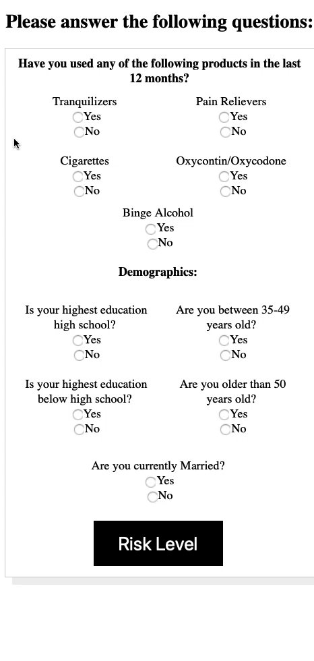
An app that can predict if somebody does illegal drugs was created

Slide 8
Key takeaways: The model high recall can help companies to save money
A company could potentially tests only 30% of the cases while achieving a relatively high recall
Confusion Matrix of Log Regression Model (Test)
TN
Assuming an average drug test cost of $100, a company that hires 10k people a year could potentially save $700k
FN
The model could also be used in schools and universities to detect drug addiction in early stages
Notes:
The model decreases false negatives (people that the model predict they don’t do drugs but in reality they do drugs
While maximizing True Negatives (people that the model predict not doing drugs and in reality they don’t do drugs).
Recall = True Positive / True Positive + False Negative

Slide 9
Questions?

